Slide 2


Thomas PIERRAIN @tpierrain
Bruno BOUCARD @brunoboucard
Tomasz JASKULA @tjaskula
Eric VERNIE @EricVernie
CQRS (without Event Sourcing)

Slide 3
Why CQRS

Slide 4
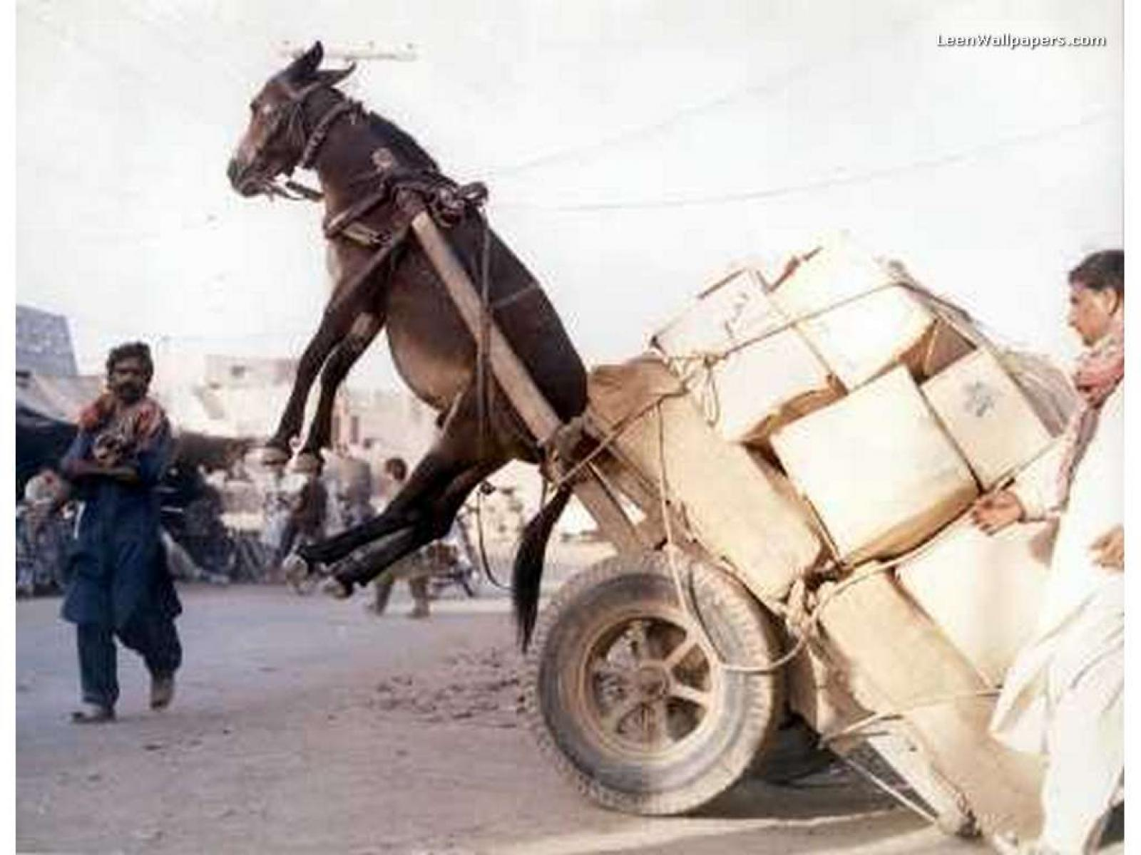
Scalability issues?
Notes:
Ref: https://s-media-cache-ak0.pinimg.com/originals/69/12/a7/6912a7bfe9d6e154c83697a5e13d13fb.jpg

Slide 5
Root cause
The Pareto Principle
80-20
20% writing
80% reading
Notes:
Ref: http://cdn.softwaretestinghelp.com/wp-content/qa/uploads/2011/06/Database-Testing.jpg

Slide 6

With…
…only one central component to deal with a wide range of constraints.
Notes:
Ref: http://cdn.softwaretestinghelp.com/wp-content/qa/uploads/2011/06/Database-Testing.jpg

Slide 7
A question
(for you)
Do you have those constraints in mind while designing your architectures?

Slide 8
So…
How to optimize an app that has to scale for massive read accesses?

Slide 9

This is where CQRS is…
Notes:
Ref: https://information2share.files.wordpress.com/2011/07/breaking-the-bottleneck.jpg

Slide 10
CQRS (short version)

Slide 11
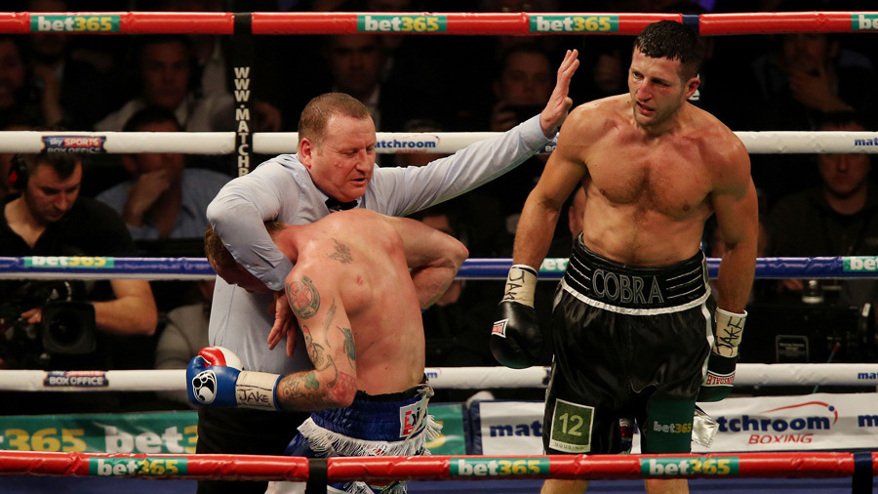
CQRS splits the 80s and the 20s
Notes:
Ref: http://ep.imgci.com/PICTURES/CMS/58500/58513.3.jpg

Slide 12

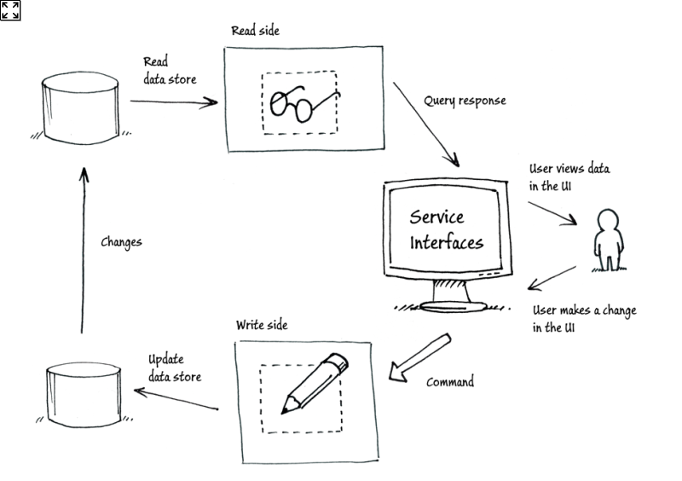

CQRS splits the 80s and the 20s
80 % of time
20 % of time

Slide 13
Behind the acronym
( powered by Greg YOUNG - @gregyoung )
C
Q
R
S

Slide 14
Behind the acronym
Command
Query
Responsibility
Segregation

Slide 15
Behind the acronym
Command
Query
Responsibility
Segregation

Slide 16
CQRS illustrated

Slide 17
CQRS illustrated

Slide 18
CQRS illustrated

Slide 19
CQRS illustrated

Slide 20
CQRS illustrated

Slide 21
CQRS illustrated

Slide 22
CQRS illustrated

Slide 23
CQRS illustrated

Slide 24
CQRS illustrated

Slide 25
CQRS illustrated

Slide 26
CQRS illustrated

Slide 27
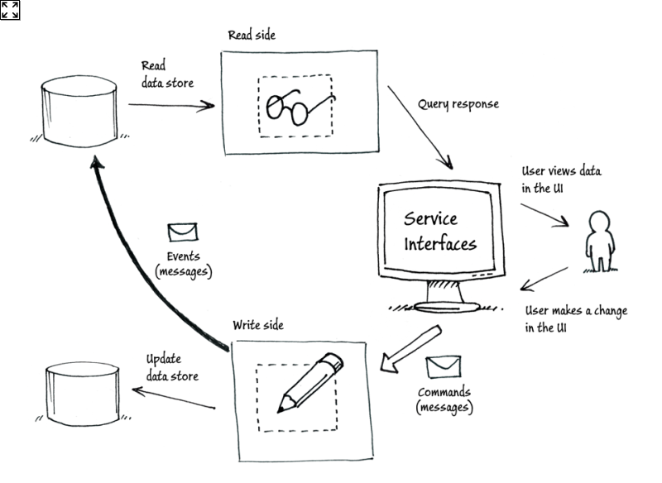
CQRS illustrated

Slide 28
CQRS illustrated

Slide 29
CQRS illustrated

Slide 30
CQRS illustrated

Slide 31
CQRS illustrated
« ready-to-eat data », Caches, non-normalized models, (no SQL)
Classical transactional databases RDBMS (ACID)

Slide 32
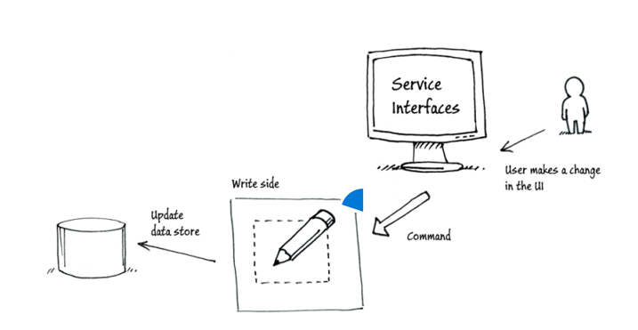
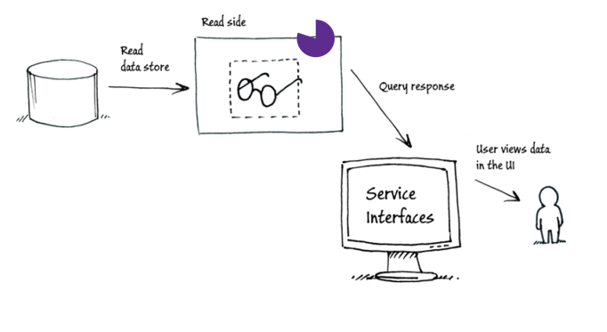
Command
Triggers an action
Modify the state of the system
>> Don’t return data ! <<
Imperative Verb
Ex: BookARoom
Query
Asks for An information
Read-only!
Get back data
Imperative Verb
Ex: GetAvailableRooms
Event
already happened (Immutable)
Past-tense Ex: RoomBooked
Notes:
Ref: http://cdn.softwaretestinghelp.com/wp-content/qa/uploads/2011/06/Database-Testing.jpg

Slide 33
Demo

Slide 34











.NET Core
// Licensed to the .NET Foundation under one or more agreements.
Open Source Implementation available on GitHub
2 main parts:
CoreClr (Runtime execution) (C++)
CoreFx (including classes, collections, file systems, xml, etc.) (C#)
ASP.NET Core 1.0 framework relies on it
Classic deployment or
Container deployment (Linux or Windows)
Notes:
CentOS 7.1Debian 8.4FreeBSD 10.1openSUSE 13.2openSUSE 42.1OS X 10.11Red Hat 7.2Fedora 23Ubuntu 14.04Ubuntu 16.04Ubuntu 16.10Windows 8.1

Slide 35
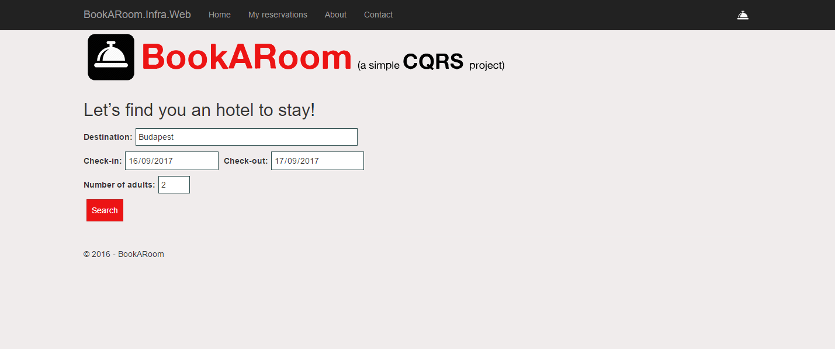
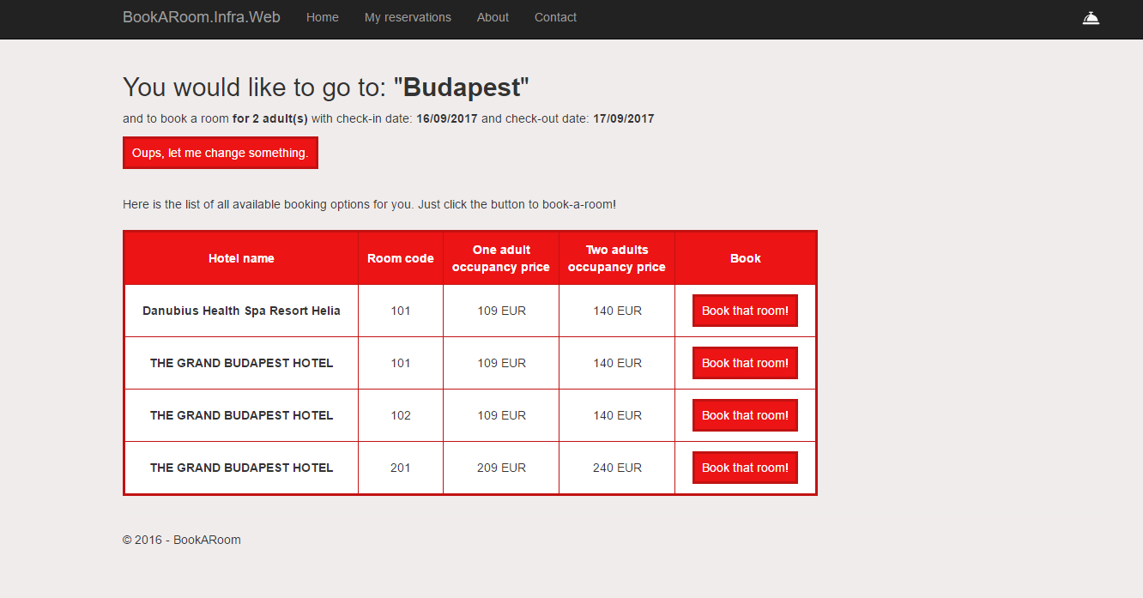

Slide 36

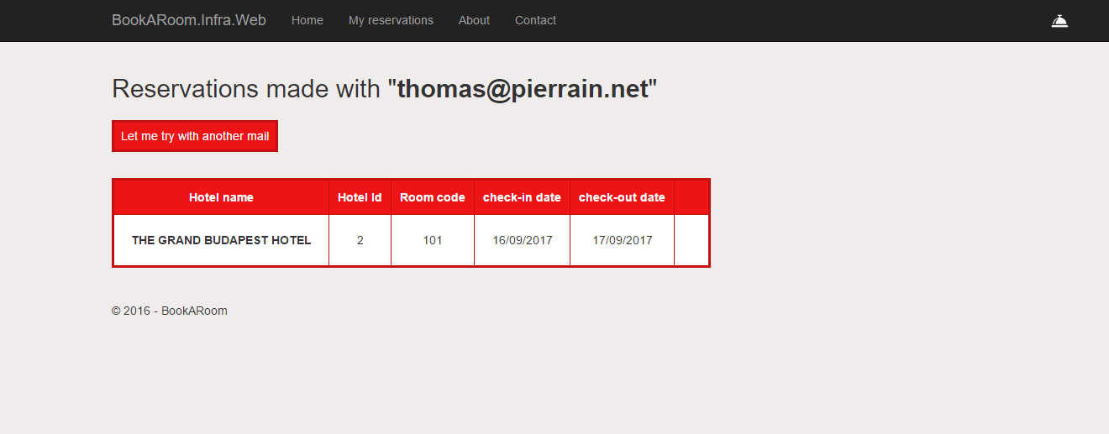

Slide 38
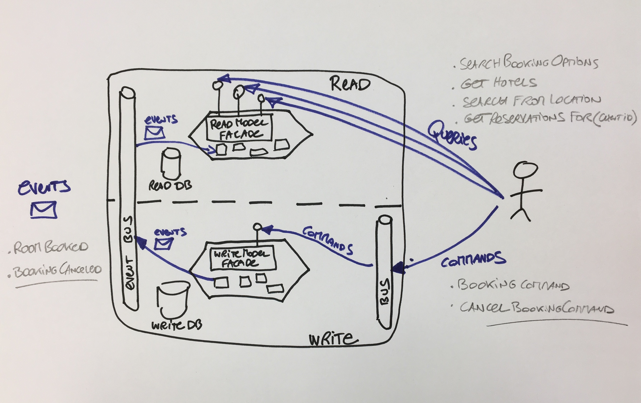

Slide 40
Live coding

Slide 41
Wrap-up

Slide 42

Warning!
Notes:
Ref: http://amgar.blog.processalimentaire.com/wp-content/uploads/2011/03/40061435.gif

Slide 43
CQRS is not…
…a top-level architecture pattern
Use it for components under stress
Do not generalize its usage for all the components of your platform!

Slide 44
Also, CQRS is not…
Event Sourcing

Slide 45

CQRS Event Sourcing
but
CQRS != Event Sourcing

Slide 46
To conclude…

Slide 47
CQRS is mostly
Well-separated read and write concerns
Queries
Commands
Caches, Ready-to-eat data (no SQL)
Transactionnal
ACID

Slide 48
Merci aussi à Rui CARVALHO, Mendel Monteiro-Beckerman, Olivier COANET et Clément BOUDEREAU ainsi que Greg YOUNG pour leurs feedbacks et idées pour ce talk.

Slide 49
CQRS origins

Slide 50
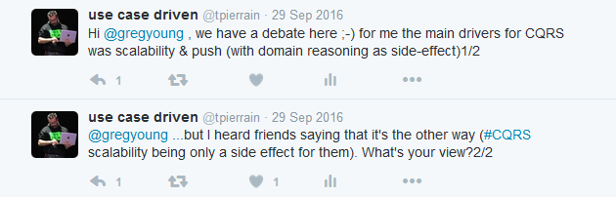
Origine de CQRS

Slide 51
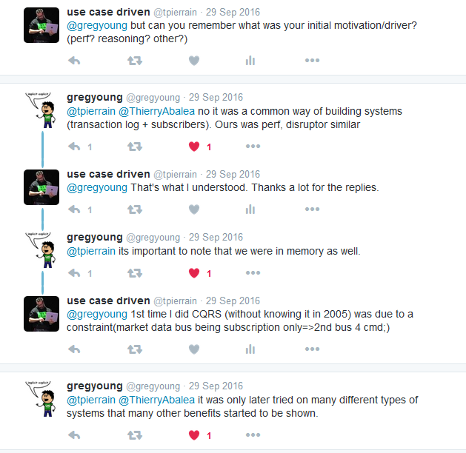
Origine de CQRS

Slide 52
Origine de CQRS

Slide 53
Wanna play the lab @home?
Follow the white rabbit here:
https://github.com/tpierrain/CQRS/blob/master/LabInstructions.md
Notes:
https://github.com/tpierrain/CQRS/blob/master/LabInstructions.md

Slide 54
@tpierrain @brunoboucard @tjaskula @EricVernie

Slide 55


